Slide 1


REAL-TIME TRAFFIC LIGHT
Experiment 2
Raphael S. Nano
CPE161P / A1
Computer Engineering Department
School of Electrical, Electronics, and Computer Engineering
Notes:
Good day to everyone! My name is Raphael S. Nano from section A1 for CPE161P, presenting experiment 1 – the Real-time basketball scoreboard.

Slide 2
Introduction: Real-Time Traffic Light
an upgrade to traditional traffic lights because of the adjustments of the time when buttons are pressed
this could possibly solve traffic jams, crime detection, and the safety of the people
Traffic lights are examples of a firm real-time embedded system
Notes:
Basketball is a sport played on a rectangular court by two teams of five players each, generally indoors. Each side attempts to score by tossing the ball through the opposing goal, which is an elevated horizontal hoop and net known as a basket. Shooting at different areas of the court would mean different points. If the shooter scores while outside the 3-point line, their team gets 3 points. If the shooter scores within the 3-point line, their team gets 2 points. Free throws, on the other hand, gives them 1 point. Knowing that, a real-time basketball scoreboard will be constructed and programmed, wherein 1, 2, or 3 points could be added or deducted every time a ball went in the basket.

Slide 3
Objectives
To demonstrate how a traffic light works in real-time.
To be able apply what you have learned in logic circuits and switching theory, microprocessors, and CPE160P.
To be able to apply real-time embedded system using the Arduino kit.
Notes:
The objectives of this experiment are the following:
1. To demonstrate how a score board for a basketball game works in real-time.
2. To be able to apply what you have learned in logic circuits and switching theory, microprocessors, and CPE160P.
3. To be able to apply real-time embedded systems using the Arduino kit.

Slide 4
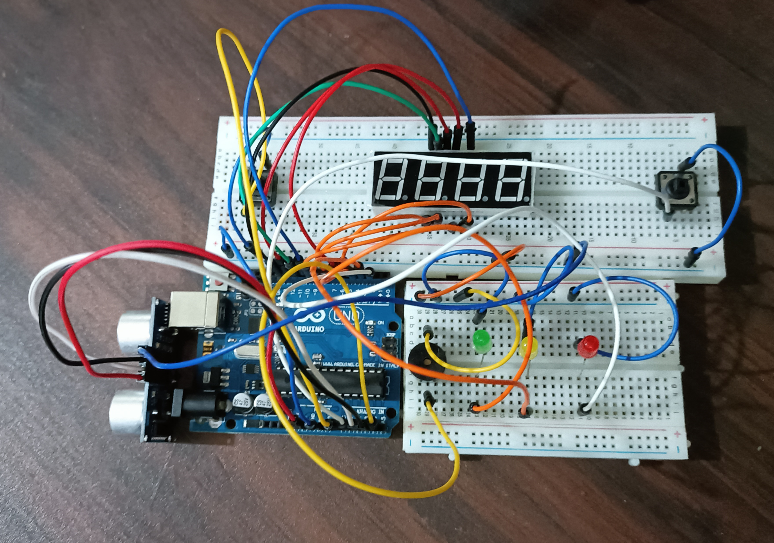
Materials
Hardware
Arduino Kit
Arduino Uno
4-Digit Seven Segment Display
3 LEDs
Ultrasonic distance sensor
Passive buzzer
Notes:
The materials utilized to construct the real-time basketball scoreboard are the Arduino UNO, the 4-digit seven segment display, and 5 switch buttons.

Slide 5

Materials
Software Libraries
Sevseg.h
Notes:
For the external library, only the SevSeg.h was used, which is for the seven segment display.

Slide 6
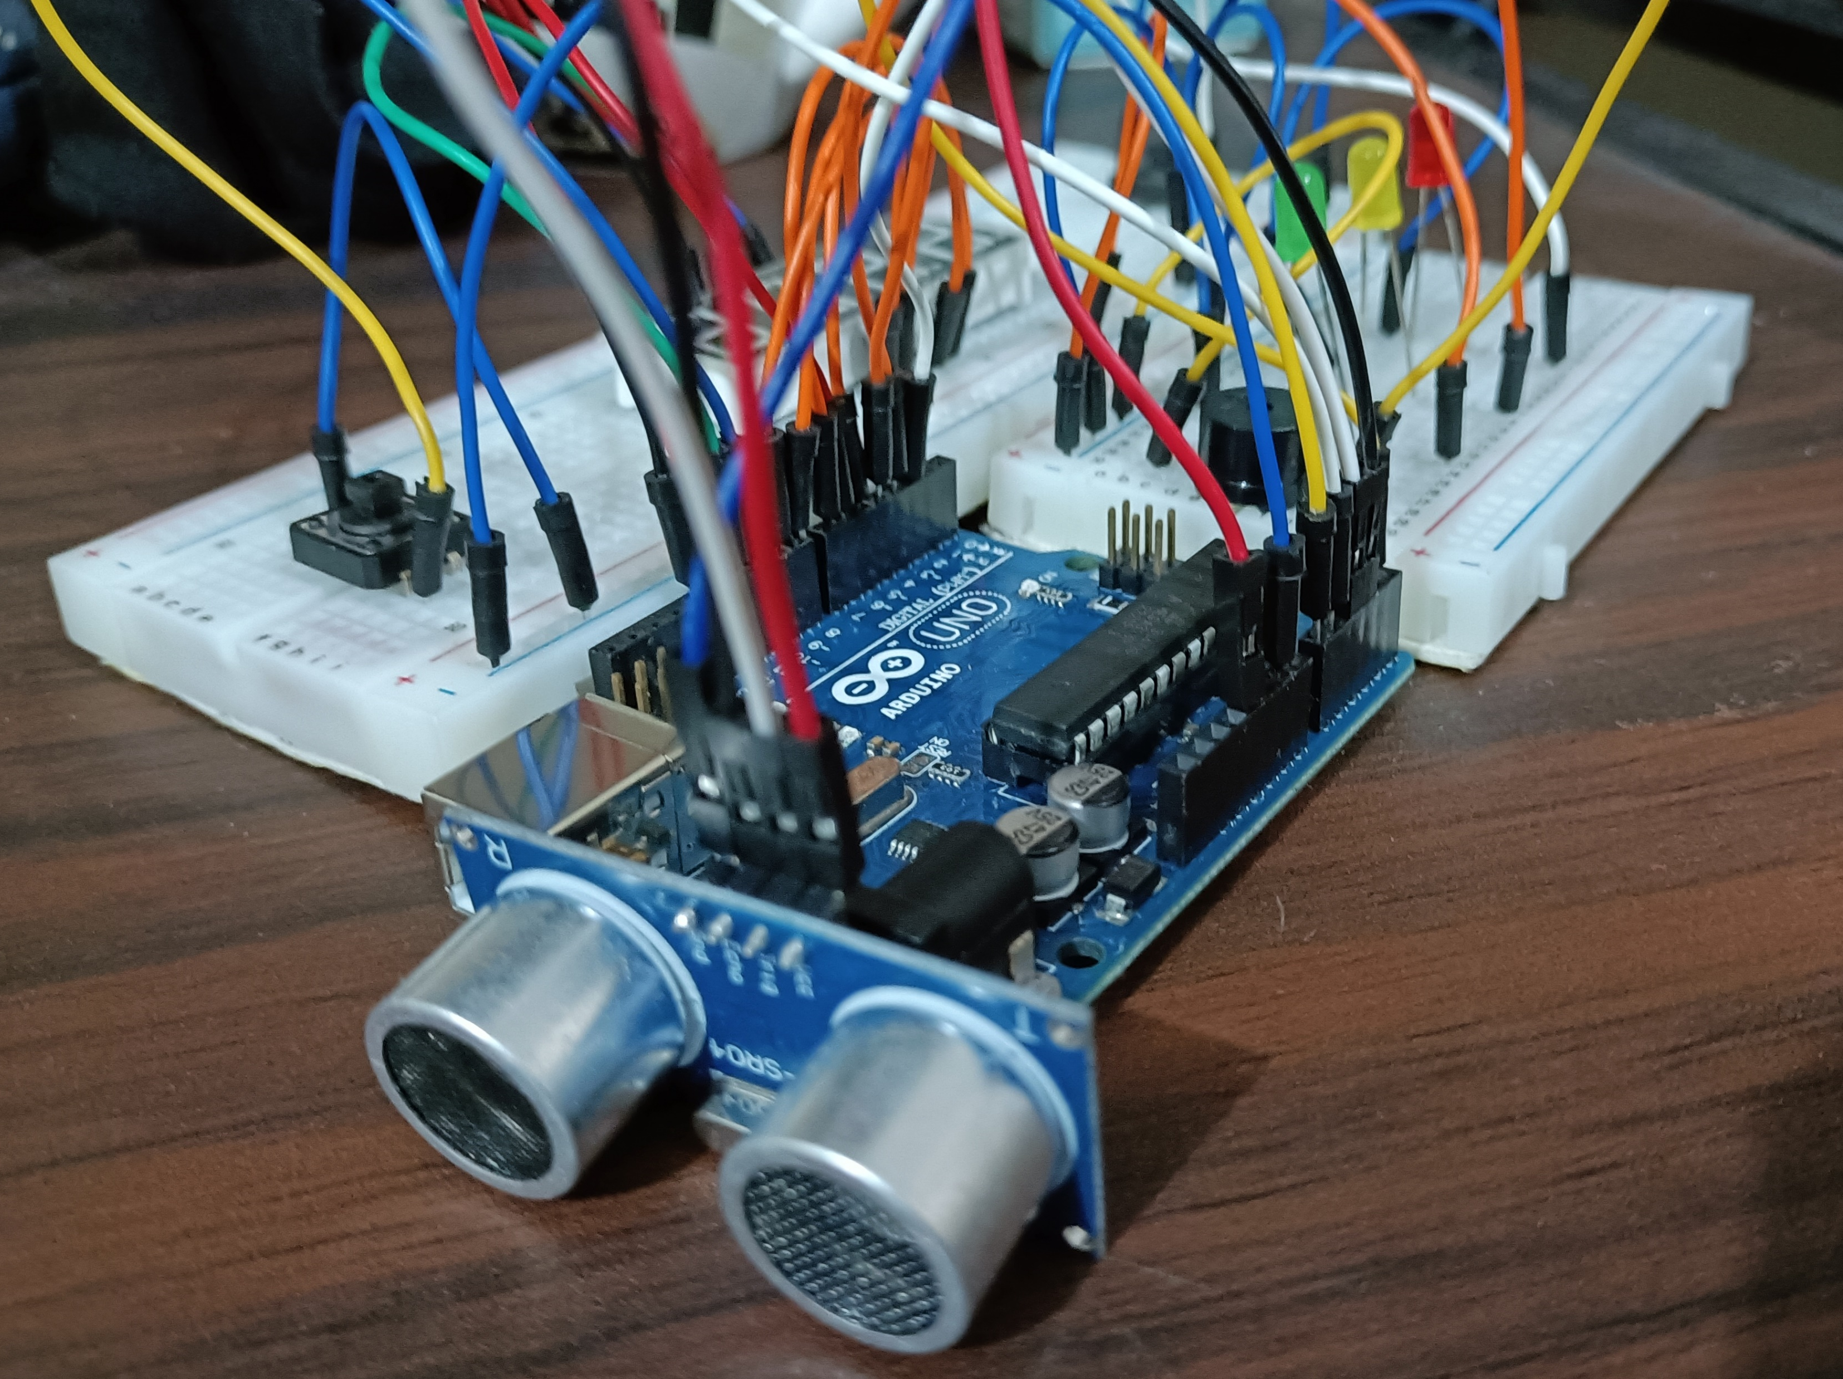
Discussion: Real-Time Traffic Light
Use three different LEDs for the stop (RED), ready (YELLOW), and go(GREEN)
Two switches were utilized to pre-empt the normal operation of the traffic lights.
First Switch: advance STOP for 15 seconds
Second Switch: Delay GO for 30 seconds
GO: 60 to 0, STOP: 0 to 60, READY: 30th second
Sensor will be used for beating the RED light
Notes:
The first experiment primarily aims to demonstrate how a scoreboard for a basketball game works in real-time. Hence, there should be no delay in adjusting or changing the values of the seven-segment display every time a button was pushed down.
Two functions were used for the adjusting of points since there are two teams to be handled. So, team1() function is used for the adding or subtracting of values for the first two digits of the 4-digit seven segment display. On the other hand, team2() function is used to adjust the values for the rightmost two digits for the seven segment display. Although there are two separate functions, their purpose is the same, and only the digits to be considered are different.

Slide 7
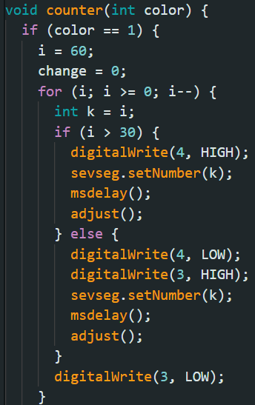
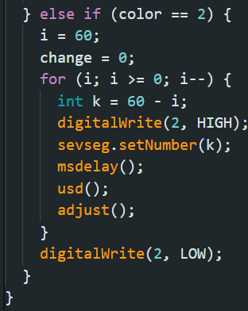
Discussion: Real-Time Traffic Light
counter() was used for the normal operation of
Color = 1 : System = GO
Color = 2 : System = STOP
For loop was used to display the count in the SSD
Count = 60
Notes:
The first experiment primarily aims to demonstrate how a scoreboard for a basketball game works in real-time. Hence, there should be no delay in adjusting or changing the values of the seven-segment display every time a button was pushed down.
Two functions were used for the adjusting of points since there are two teams to be handled. So, team1() function is used for the adding or subtracting of values for the first two digits of the 4-digit seven segment display. On the other hand, team2() function is used to adjust the values for the rightmost two digits for the seven segment display. Although there are two separate functions, their purpose is the same, and only the digits to be considered are different.

Slide 8
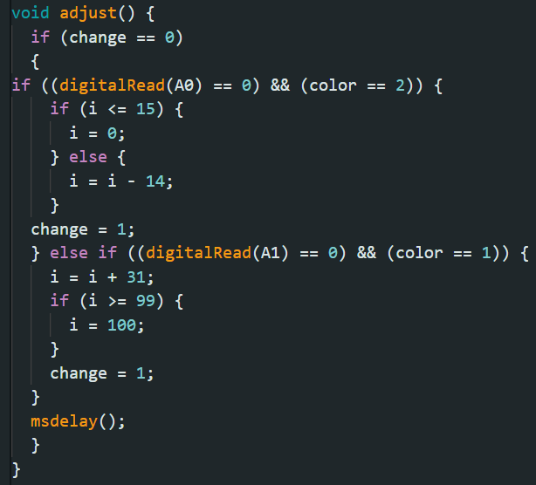
Discussion: Real-Time Traffic Light
In adjust(), the value of the ‘i' is being changed, depending on what button was pressed
If the color is RED and first button was pressed, time advances 15 seconds
If the color is GREEN/YELLOW and second button was pressed, time delays 30 seconds
If the value of i exceeds its maximum or minimum value, it stays on the max or min value
Notes:
The first experiment primarily aims to demonstrate how a scoreboard for a basketball game works in real-time. Hence, there should be no delay in adjusting or changing the values of the seven-segment display every time a button was pushed down.
Two functions were used for the adjusting of points since there are two teams to be handled. So, team1() function is used for the adding or subtracting of values for the first two digits of the 4-digit seven segment display. On the other hand, team2() function is used to adjust the values for the rightmost two digits for the seven segment display. Although there are two separate functions, their purpose is the same, and only the digits to be considered are different.

Slide 9
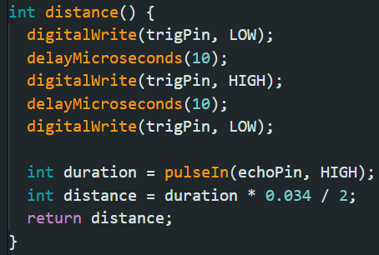
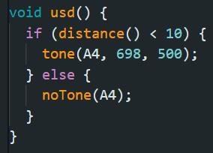
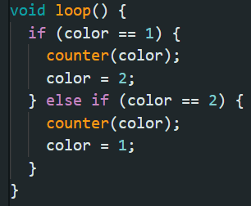
Discussion: Real-Time Traffic Light
For the USD, distance() function was created
Formula: duration of the wave's traversal multiplied with 0.034 / 2
usd() function was created for the buzzer
If distance is less than 10 cm and the light is RED, the alarm will sound
main loop passes color value to counter() function
Notes:
The first experiment primarily aims to demonstrate how a scoreboard for a basketball game works in real-time. Hence, there should be no delay in adjusting or changing the values of the seven-segment display every time a button was pushed down.
Two functions were used for the adjusting of points since there are two teams to be handled. So, team1() function is used for the adding or subtracting of values for the first two digits of the 4-digit seven segment display. On the other hand, team2() function is used to adjust the values for the rightmost two digits for the seven segment display. Although there are two separate functions, their purpose is the same, and only the digits to be considered are different.

Slide 10
Conclusion
The real-time traffic light system works in three functions:
  Normal operations:
    STOP operation is from 0 to 60
    GO operation is from 60 to 0
    30th second of GO operation turns the color of the LED to yellow
  Adjustment of values with the use of buttons:
    First button advances 15 seconds while in STOP
    Second button delays 30 seconds while in GO
  Detection of ultrasonic distance sensor for beating the red light

Slide 11
Conclusion
The use of microprocessors, logic circuits, and switching theory is shown using series connections, pin layouts, and sensor and LED triggering.
As a result of using numerous variables, modules, and invoking such functions to create an embedded system, a real-time traffic light system was successfully constructed and shown in a basic handshaking.

